Slide 1
WELCOME TO YEAR 2
Miss Peters

Slide 2
Miss Peters - Class teacher Mrs Wingfield - LSA Mrs Pascal - LSA/ Pastoral

Slide 3
Please ensure your child arrives on time. Hannah Ball School does a soft start between 8.45 and 8.55.
Year 2 do morning activities on arrival in the classroom; handwriting, spelling and maths.
The earlier your child arrives, the more opportunity they will have to learn.
Your child will be missing out on vital learning time if they are late.
It is also important to collect your child promptly at 3.10p.m. If you are delayed for any reason, please contact the school so your child can be informed and taken to the foyer to wait for you in a comfortable place.

Slide 4
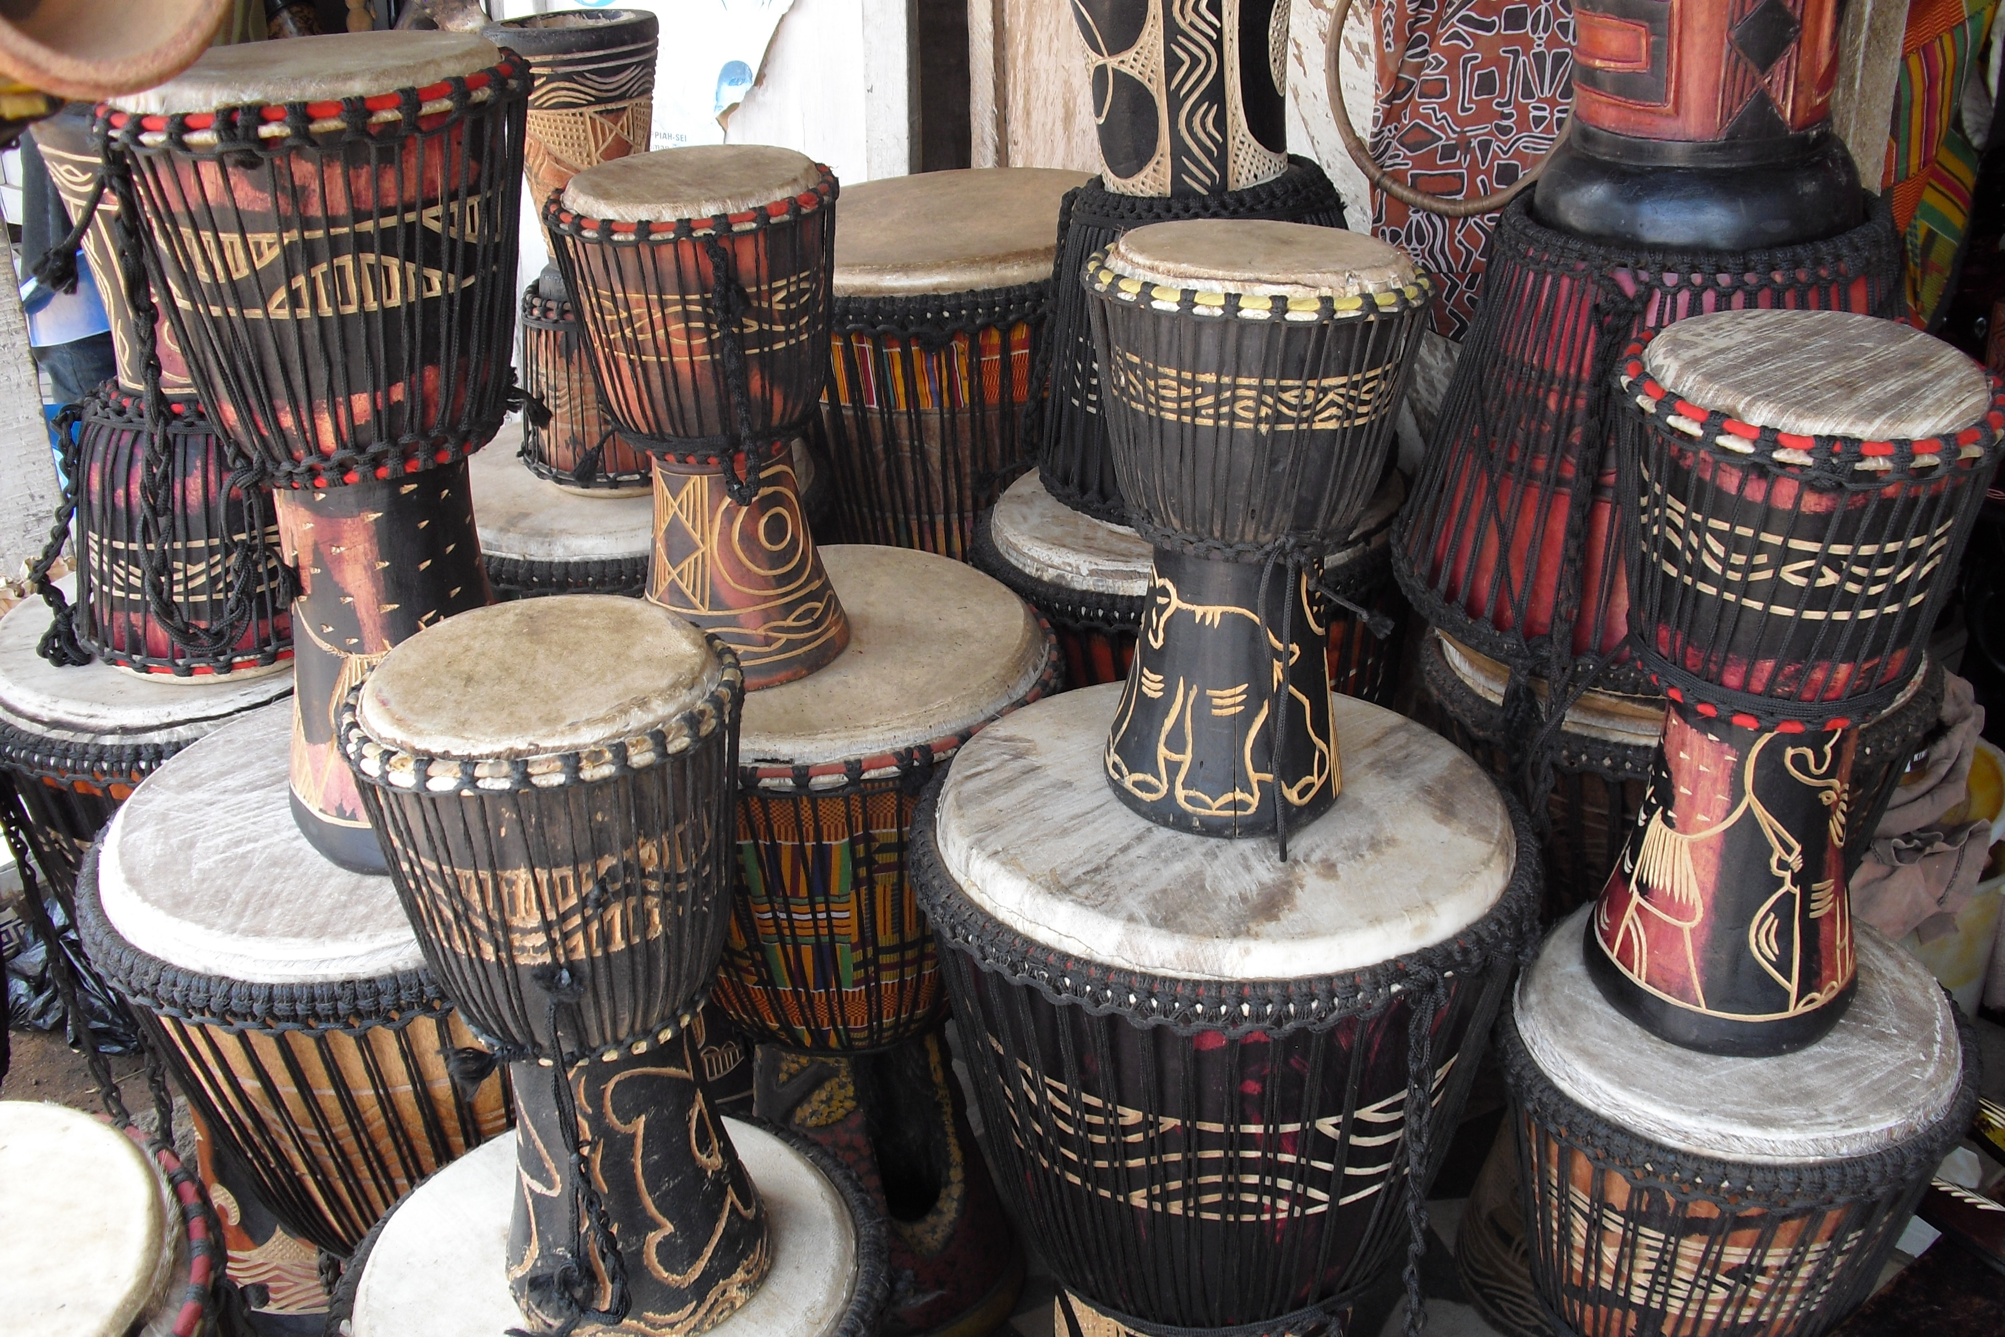
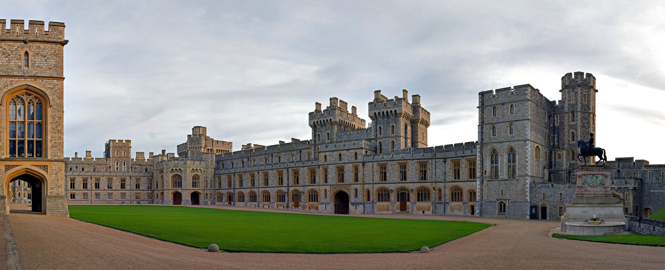
Visits and experiences

Slide 5
Uniform and PE kit
Mid-grey trousers/skirts
Summer - boys can wear shorts, girls summer dresses.
White polo shirt
Red school jumper, round neck
Grey socks or tights
Plain black shoes with sensible fastenings that your child can manage independently

Slide 6
PE kit Your child will arrive in school in their PE kit on PE days. Currently this is a Wednesday and Friday.
Plain black shorts or joggers
White school logo t-shirt or plain white t-shirt.
Plain black sweatshirt
Plain black plimsolls or trainers

Slide 7
All items must be labelled.
Any non-labelled items left at the end of the day will be placed in lost property.

Slide 8
Reading
Daily reading is vital! Your child must read everyday, and you must sign their planner. They should bring this in every day.
Listen to your child read every day and sign their planner. Until they get to Orange level they need to read the book twice to gain fluency in their reading.
Initially your child will have their book changed when they have read it twice at home.
Enjoy sharing Library books with your child, they will visit the school library once a week and you can pre-order books from home.

Slide 9
Phonics and reading
Children need to be able to decode words using the letter sounds.
Practice these sounds and key words daily as part of your reading session.
Spellings will be sent home. Please practise these with your child in order for them to make progress.
Examples of the sounds the letters make singularly and when combined.
Phase 2 https://www.youtube.com/watch?v=DIpcahxNSU4
Phase 3 https://www.youtube.com/watch?v=vU2vWZKS7rY
Phase 5 https://www.youtube.com/watch?v=R3S5sJw7MfI

Slide 10
MyON
This is a virtual library of books that your child has access to.
https://www.myon.co.uk/login/
The children can read the books or listen to the books being read to them.
You can listen to books/stories together.
A Myon project will be set every holiday to introduce your child to their next topic. We will also set a project for them to do each half term to support their learning at school.
AR quizzes – When your child reaches Orange level they will be able to do quizzes that support their understanding of the books they are reading.
Completing these quizzes regularly will help your child to make progress.

Slide 11
Is their anything else you would like to know? I am usually available for a chat after school, once the children are dismissed, if you need anything or have any concerns about your child please email the office and we can arrange an appointment. Thank you, Miss Peters

